Slide 1



Sept Bogo DOD (Pros and RM)
View in Power BI
Last data refresh:
10/5/2023 10:54:31 AM UTC
Downloaded at:
12/9/2023 8:32:23 AM UTC

Slide 2
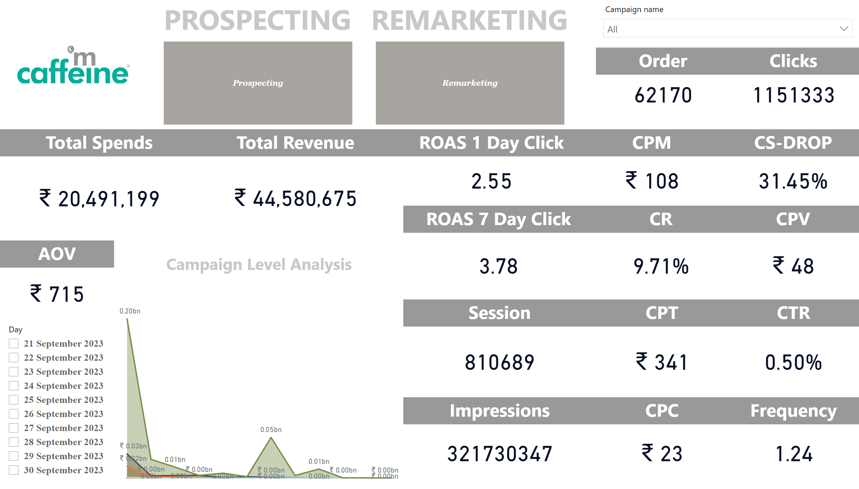
Page 1
Notes:
CR
No alt text provided
CPC
No alt text provided
CS-DROP
No alt text provided
image
No alt text provided
slicer
No alt text provided
CPM
No alt text provided
Clicks
No alt text provided
Frequency
No alt text provided
Order
No alt text provided
Impressions
No alt text provided
ROAS 7 Day Click
No alt text provided
CPV
No alt text provided
CPT
No alt text provided
ROAS 1 Day Click
No alt text provided
Session
No alt text provided
Total Revenue
No alt text provided
Total Spends
No alt text provided
slicer
No alt text provided
REMARKETING
No alt text provided
PROSPECTING
No alt text provided
CTR
No alt text provided
AOV
No alt text provided
Campaign Level Analysis
No alt text provided

